Slide 1
Logistic regression in pytorch

Slide 2
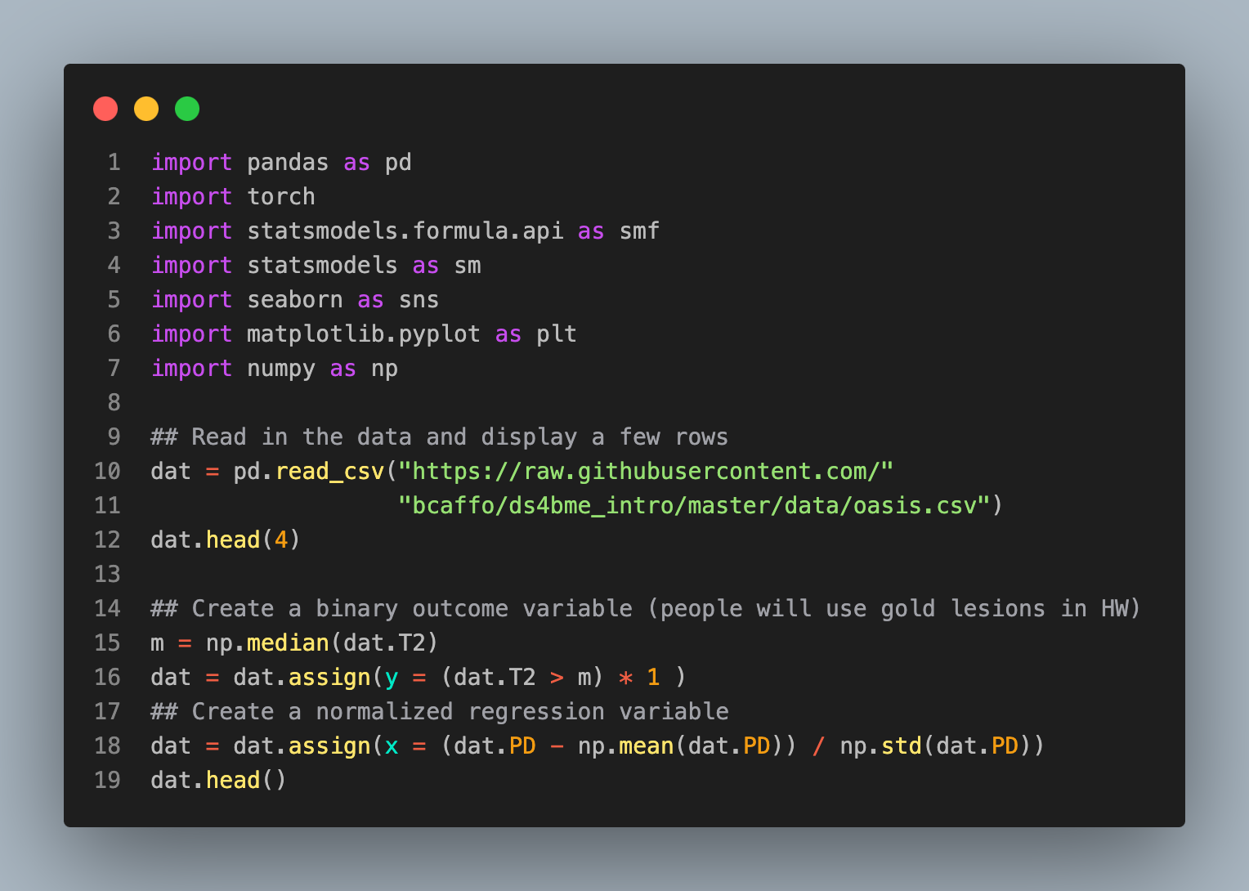
FLAIR | PD | T1 | T2 | FLAIR_10 | PD_10 | T1_10 | T2_10 | FLAIR_20 | PD_20 | T1_20 | T2_20 | GOLD_Lesions | y | x
0 | 1.1436 | 1.5862 | -0.7998 | 1.6344 | 0.437568 | 0.8238 | -0.0020 | 0.5736 | 0.2798 | 0.5483 | 0.2191 | 0.29866 | 0 | 1 | 1.181
1 | 1.6525 | 1.7666 | -1.2509 | 0.9212 | 0.663037 | 0.8802 | -0.4220 | 0.5425 | 0.4221 | 0.5497 | 0.0615 | 0.28097 | 0 | 1 | 1.426
2 | 1.0360 | 0.2620 | -0.8585 | -0.0582 | -0.0442 | -0.3085 | 0.0147 | -0.2560 | -0.1365 | -0.3509 | 0.0206 | -0.25991 | 0 | 0 | -0.614
3 | 1.0376 | 0.0111 | -1.2287 | -0.4702 | -0.0139 | -0.0004 | -0.3955 | -0.2219 | 0.0008 | -0.0030 | -0.1932 | -0.13928 | 0 | 0 | -0.955
4 | 1.5805 | 1.7301 | -0.8609 | 1.2456 | 0.6179 | 0.86635 | -0.0999 | 0.3842 | 0.3911 | 0.6088 | 0.0716 | 0.34060 | 0 | 1 | 1.376

Slide 3
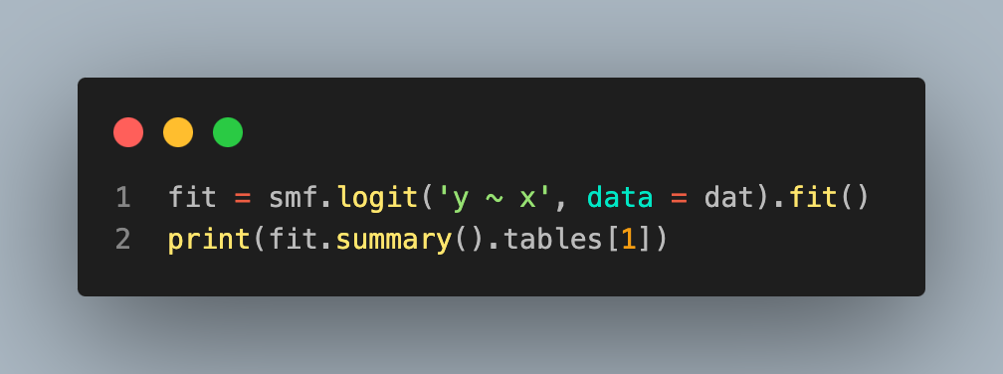
Optimization terminated successfully.
Current function value: 0.427855
Iterations 7
==============================================================================
coef std err z P>|z| [0.025 0.975]
------------------------------------------------------------------------------
Intercept 0.0367 0.269 0.136 0.892 -0.491 0.565
x 2.2226 0.436 5.095 0.000 1.368 3.078
==============================================================================

Slide 4
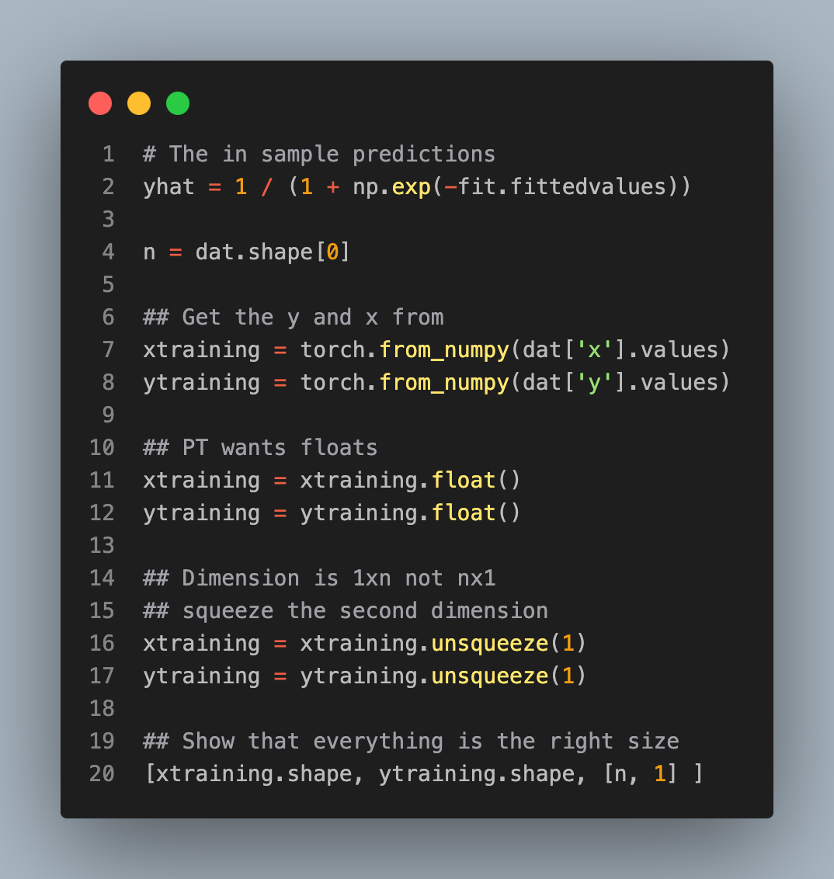
[torch.Size([100, 1]), torch.Size([100, 1]), [100, 1]]

Slide 5
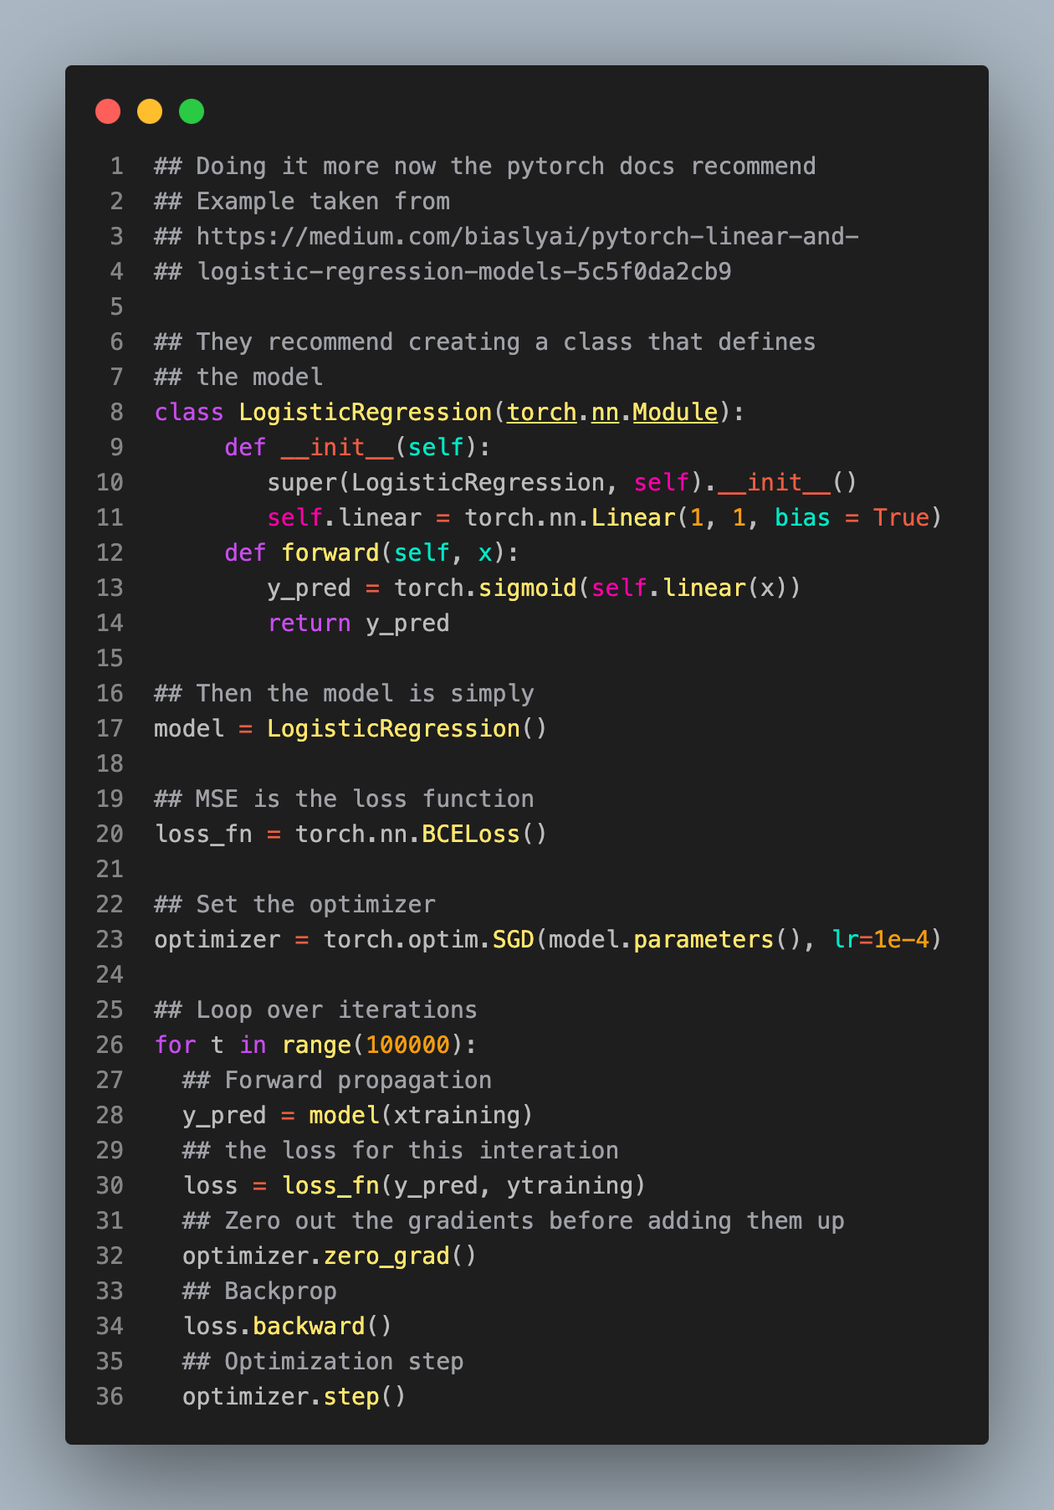
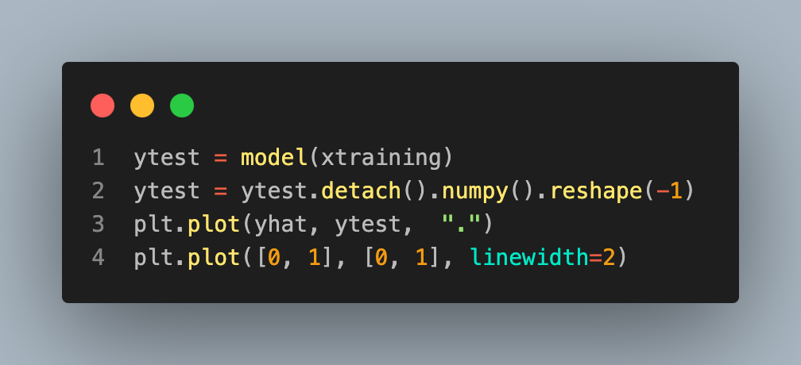
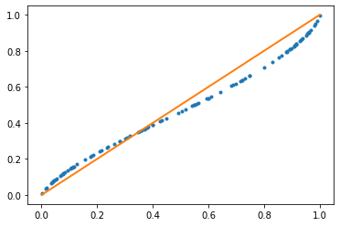

Slide 6
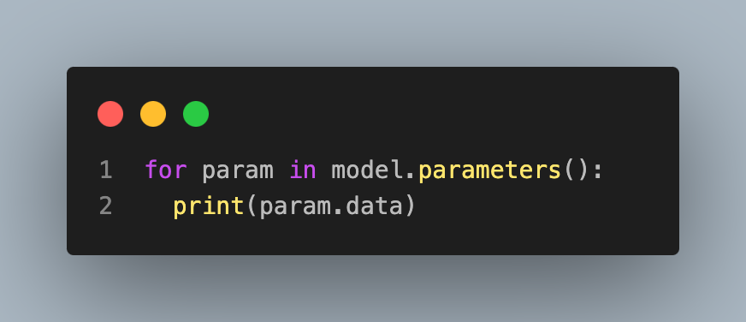
tensor([[1.6660]])
tensor([-0.1225])

